Slide 1
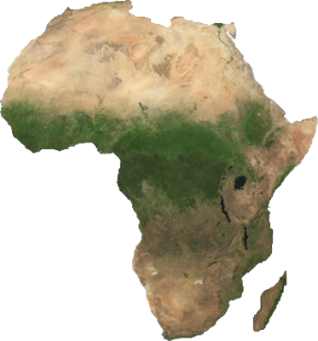
Remember Africa
www.donotyet.com/tag/africa/
Lee Ann Harrelson
Teacher Consultant
Oklahoma Alliance for Geographic Education

Slide 2
Oklahoma C³ Standards for the Social Studies:
Process and Literacy Skills:
Grade 7: World Geography –Eastern Hemisphere
1.C.7. – Integrate visual information (e.g., in charts, graphs, photographs, videos, or maps) with other information in print and digital texts.
2.A.b. – Support claim(s) with logical reasoning and relevant, accurate data and evidence that demonstrate an understanding of the topic or text, using credible sources.
Content Skills:
Grade 7: World Geography – Eastern Hemisphere
1.4. – Integrate visual information and apply the skill of mental mapping of the political and physical features of Earth’s surface and to organize information about people, places, and environments.
3.1. – Integrate visual information to identify on a physical map and describe the major landforms and bodies of water including
A. Landforms – the Iberian, Scandinavian, and Indochina Peninsulas; the Urals, Pyrenees, Alps, and Himalayan Mountain Ranges; the Sahara, Kalahari, and Gobi Deserts; and the Great Rift Valley.
B. Bodies of water – Danube, Volga, Nile, Congo, Niger, Tigris, Euphrates, Indus, Ganges, and Yangtze Rivers; Mediterranean, Arabian and North Seas; Persian Gulf, Bay of Bengal; Strait of Gibraltar; Atlantic, Arctic, Indian, Pacific, and the Southern Oceans.

Slide 3
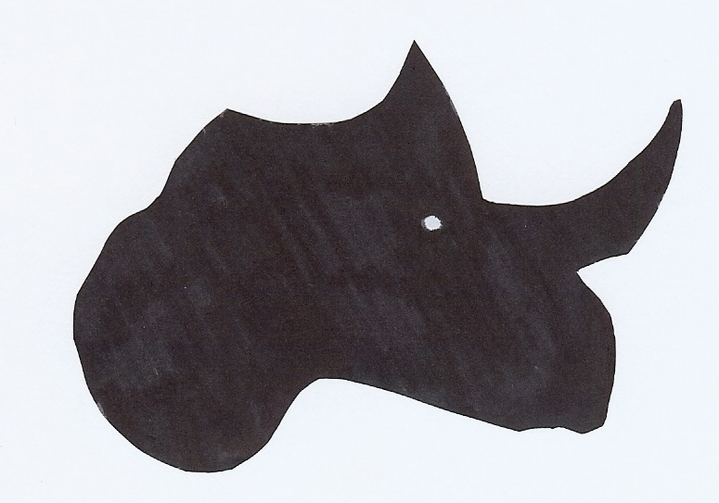
What is this?
The African Rhino

Slide 4
Objectives:
Students will be able to draw an outline map of Africa
from memory.
Students will learn the locations of specific geographic
features of Africa by labeling them on a map.
Students will understand why the African rhinoceros
has become endangered.

Slide 5
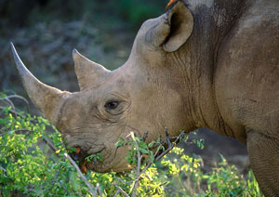
www.safarinow.com/cms/african-rhino/irie.aspx
All 5 species are seriously endangered.
There are 5 species of rhinoceros:
3 are found in Asia and 2 in Africa.
There are only about 25,000 rhinos left in Africa, mostly in South Africa.
Of those, there are only about 3,000 left in their natural habitat.
The African rhinoceros have 2 horns.
Notes:
The closest living relative to the rhinoceros is the horse. The horns of the rhinos were first thought to be made of tightly compacted hair. They are actually made of keratin, much like our fingernails. The horns are similar to horses’ hooves.

Slide 6
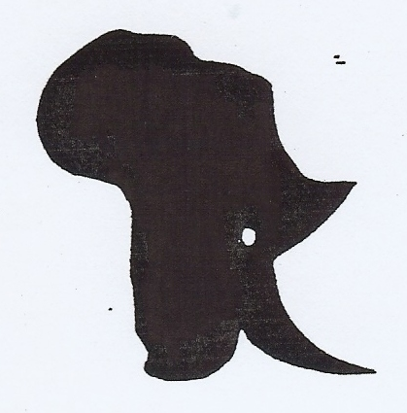
Turn head to new position

Slide 7
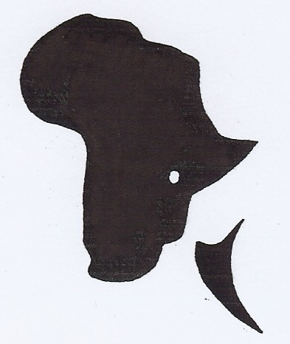
To help save the rhino, its horn has been cut off.
Notice that one has not been cut yet.

Slide 8
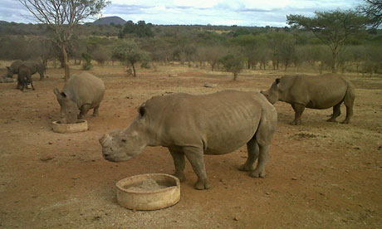
When poachers remove the horns, they cut too deep in order
to get as much horn as possible, thus leaving the animal
to bleed to death. It is very cruel, painful, and gory.
In efforts to save the rhinoceros from poachers, veterinarians
have surgically removed the large horn.
This expensive process is not the ideal solution to the poaching problem
because this horn is part of their defense against predators and the way in which
they grub for food. These dehorned rhinos must be kept in protected areas.
Notes:
Dehorning is a 20-minute painless procedure. The horns grow back at a rate of about 1 kg per year. One rhino may produce 6-8 horns in a lifetime. There was a politician who claimed ingesting ground rhino horn cured his cancer. There was no scientific proof to back this case, but the rumor went viral and the demand in Vietnam for rhino horns increased dramatically.

Slide 9
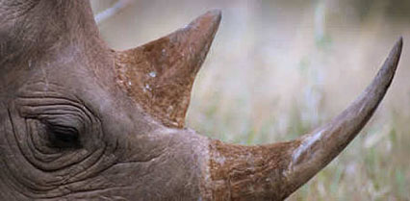
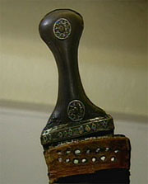
One of the reasons for high demand of the
rhino horn is for Asian medicinal purposes.
http://friedkinfund.wordpress.com/2010/05/26/south-african-black-rhinos-flown-to-tanzania/
Another demand for the horn is the
Yemen practice of presenting
a dagger made from the rhino horn
to 12 year old boys as a sign of manhood
and devotion to the Muslim religion.
http://www.pbs.org/wnet/nature/episodes/rhinoceros/rhino-horn-use-fact-vs-fiction/1178/
Notes:
The claim that ground rhinoceros horns have medicinal purposes has never been scientifically proven. Scientists say that you would get as much benefit if you chewed on your fingernails since they both made of keratin.
Exports of rhino horns to Yemen were banned in 1982, but they are still being smuggled into the country. These daggers are called “Jambiya”. They are commonly studded with jewels.

Slide 10
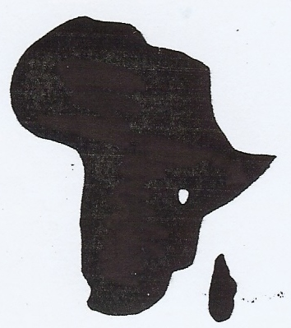
The horn that has been cut has become only a small fragment.
This fragment
becomes
Madagascar.
You now have the continent of Africa.

Slide 11
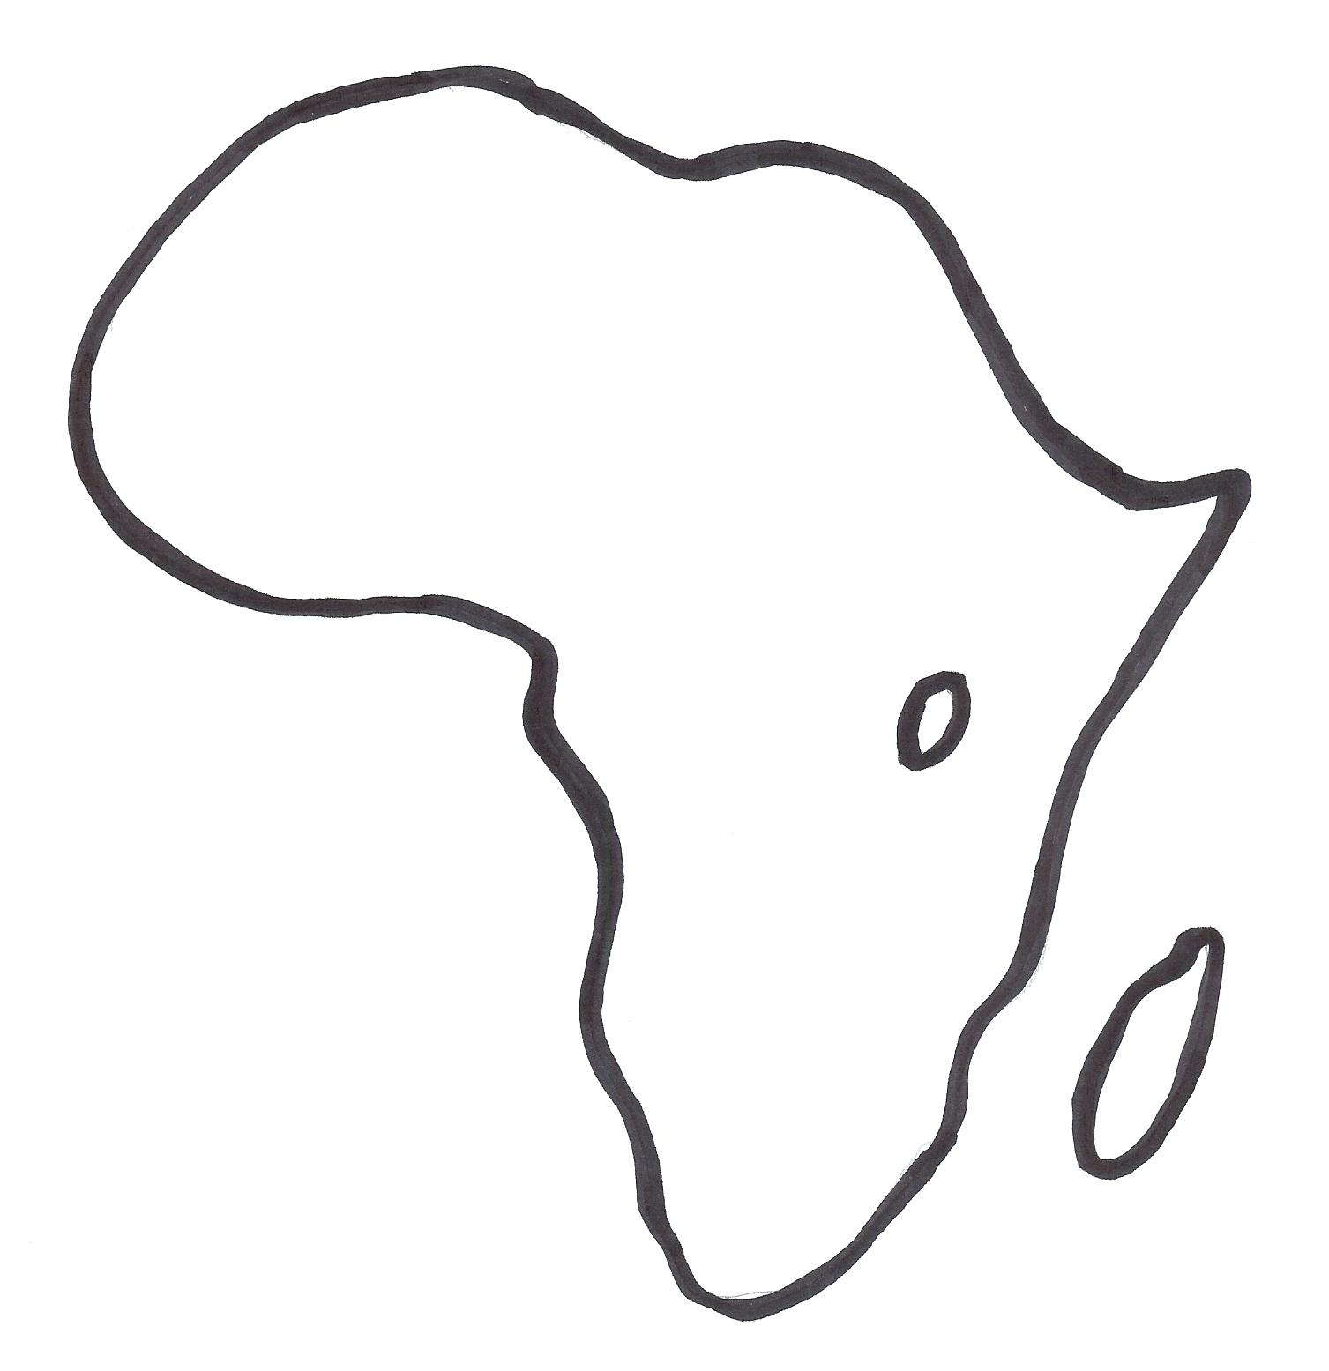
Thick muscle hump - Mediterranean Sea with Atlas Mts. above
Horn still attached -Horn of Africa
Neck - Western peninsula of Africa
Eye – Lake Victoria
Cut off horn -Madagascar
Muzzle or mouth area -South Africa
Hooked up lip -
Cape of Good Hope

Slide 12
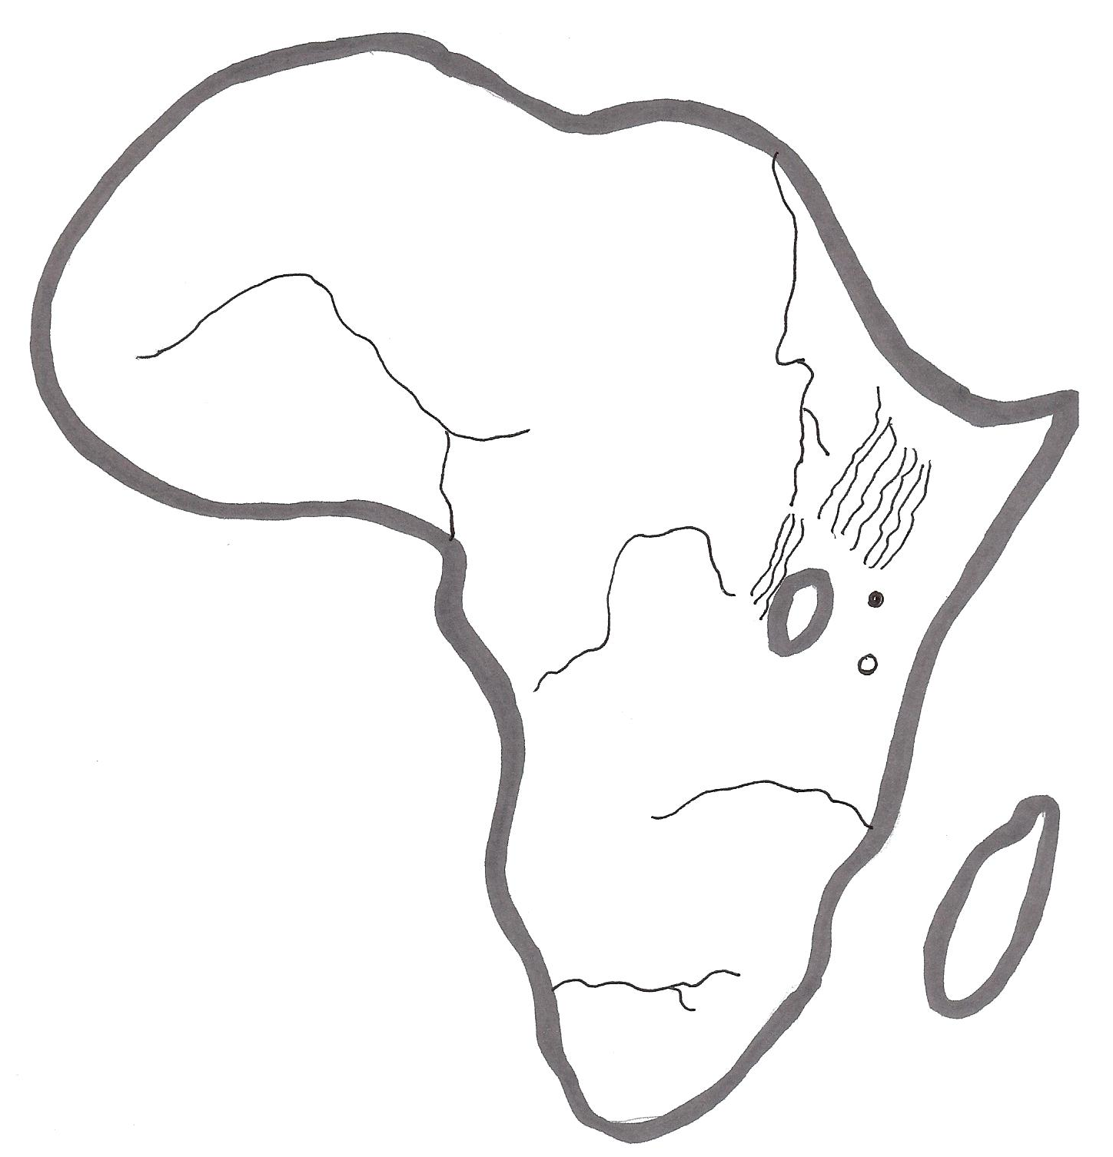
Major Skin Folds
Niger River
Nile River – Blue & White
Lines around the eyes-
Ethiopian Highlands
Great Rift Valley
Congo River
2 ticks –
Mt. Kenya
Mt. Kilimanjaro
Zambezi River
Orange River

Slide 13
Mental Mapping
Now let’s use our mental mapping skills to draw the
continent of Africa by picturing it as an African Rhino head.
Now label the following on your map:
Horn of Africa
Madagascar
Lake Victoria
Cape of Good Hope
South Africa
Western peninsula of Africa
Mediterranean Sea
Great Rift Valley/Ethiopian Highlands
Mt. Kenya/Mt. Kilimanjaro
Nile River – White and Blue
Zambezi River
Orange River
Congo River
Niger River
Now look at a physical map of Africa and see how well you did!
Notes:
Give students a sheet of blank paper to draw the continent of Africa or use the blank map provided in the lesson. Have them label the physical features listed on this slide. A list is also included in the lesson if you need to print it off for students.

Slide 14
Student Examples

Slide 15
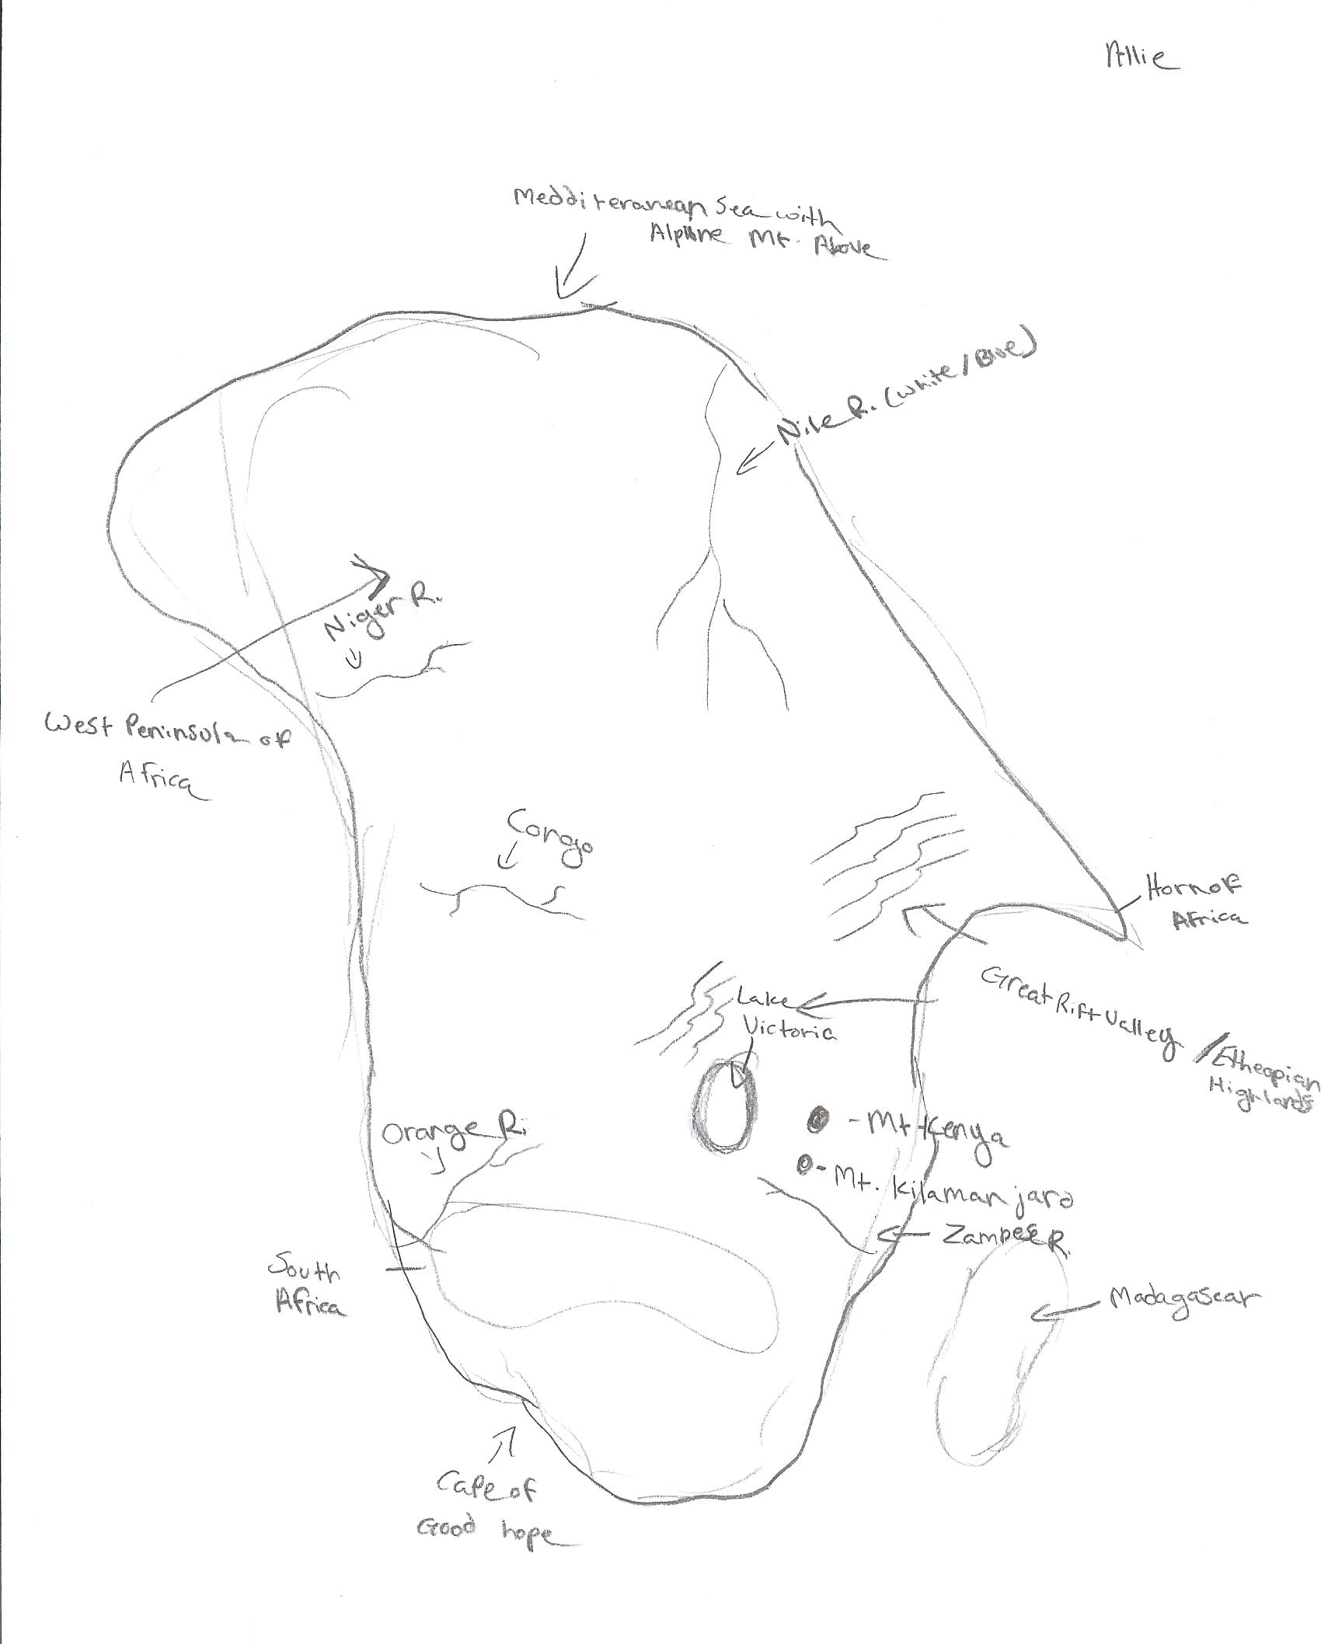
Example of
freehand
drawing

Slide 16
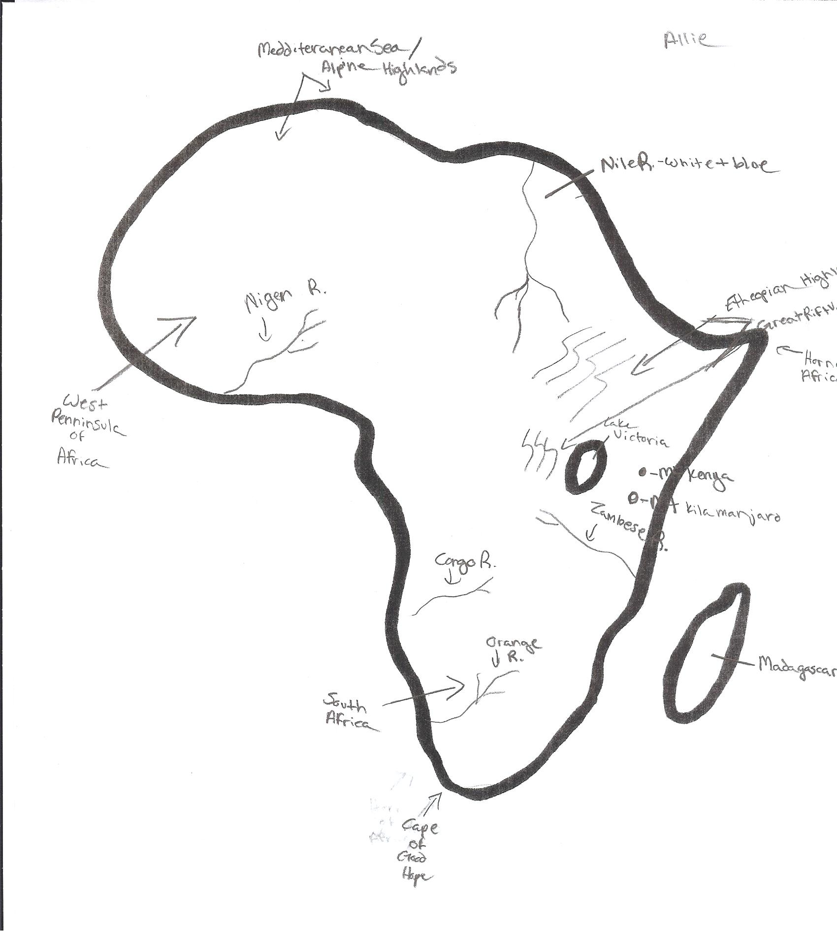
Example using
outline map
of Africa.

Slide 17
Extension Activity

Slide 18
Writing Activity
One idea that has been suggested is to legalize
the sale of the rhinoceros horns to help stop poaching.
Do you think this is a good or bad idea?
Explain your answer.

